Slide 1
LINEAR REGRESSION
Moses Ngari

Slide 2
Introduction
Linear Regression with One Predictor variable
Regression analysis is a statistical methodology that utilizes the relation between two or more quantitative variables so that a response or outcome variable can be predicted from the other, or others.
Examples of regression method;-
1 The length of hospital stay of a surgical patient can be predicted by utilizing the relationship between the time in the hospital and the severity of the operation.
2 Sales of a product can be predicted by utilizing relationship between sales and amount of advertising expenditures.

Slide 3
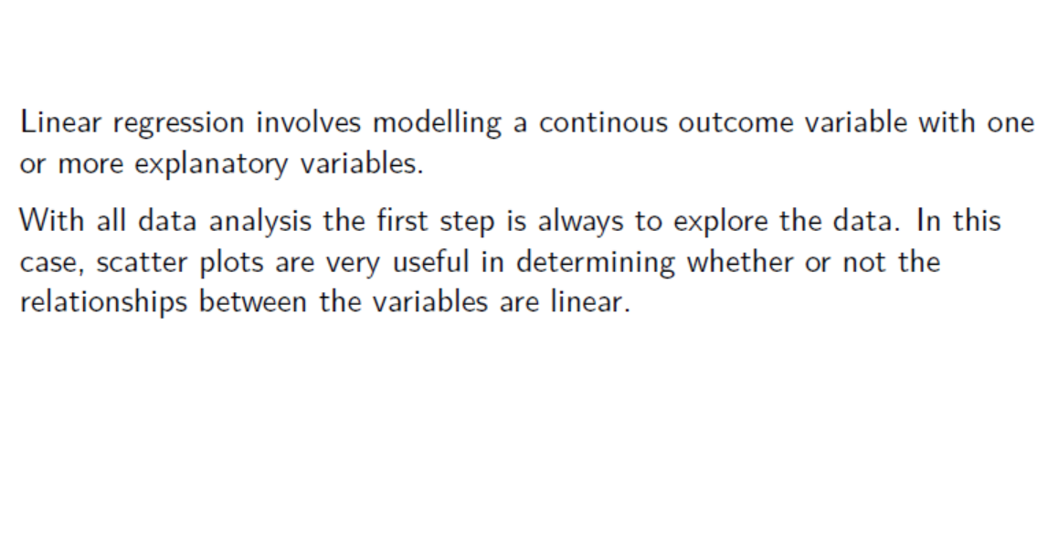

Slide 4
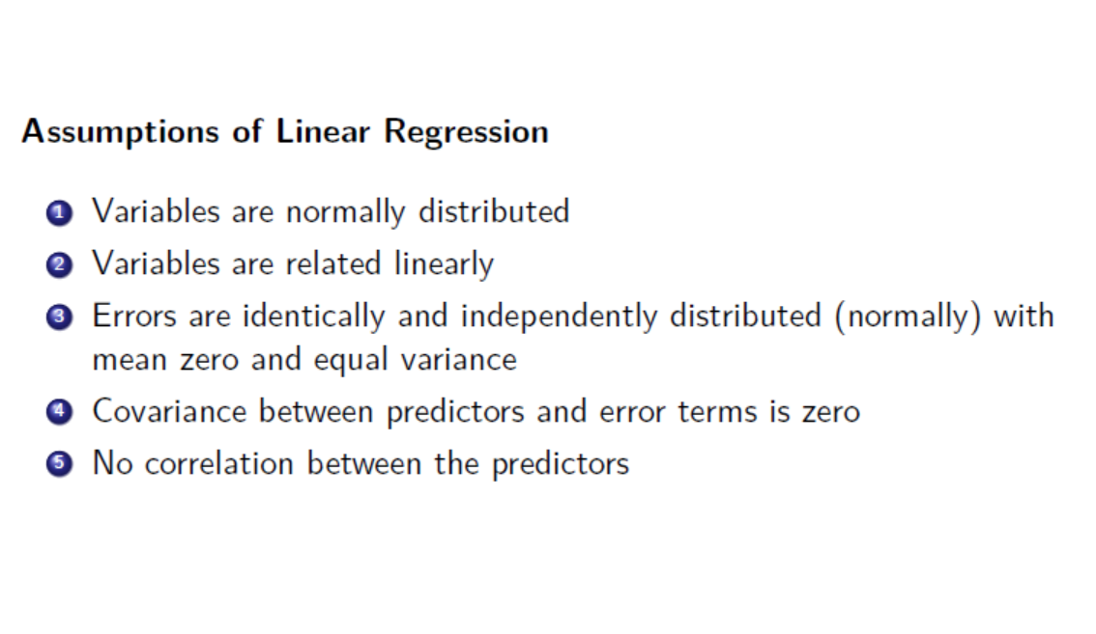

Slide 5
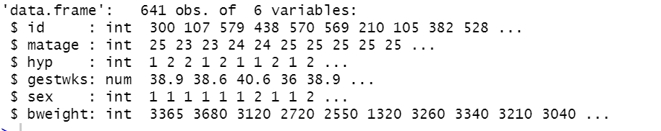
Data Description
Dataset (babies.csv) to be used for this section concerns the relationship between birthweight and gestational age in weeks.
The objective of this analysis is to examine the relationship between: birthweight (outcome) and gestwks

Slide 6
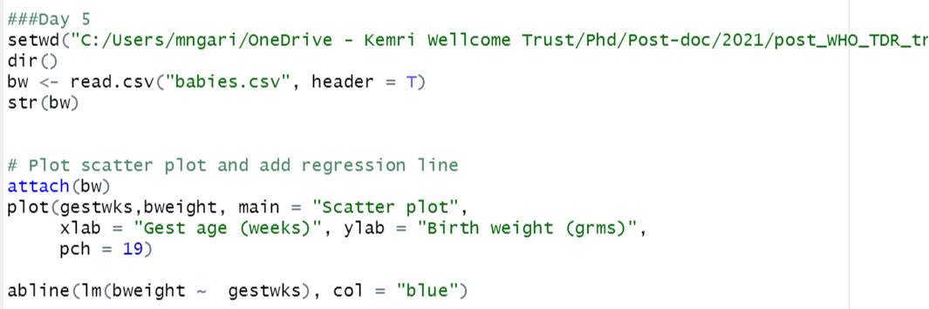
Graphical representation - Scatter plots

Slide 7
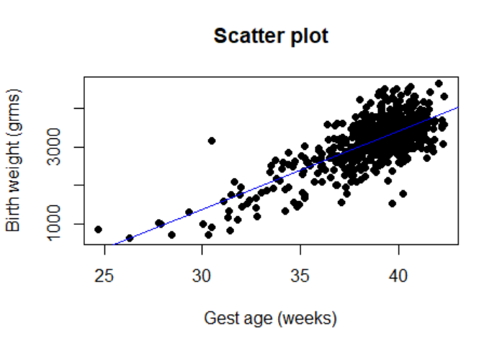

Slide 8
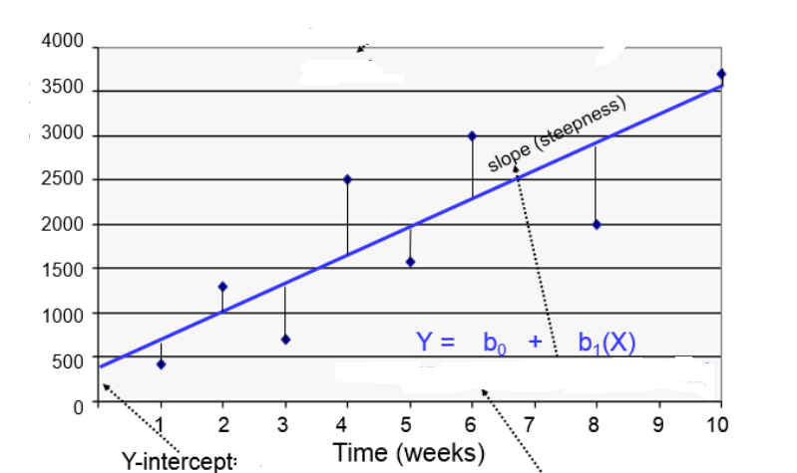

Slide 9
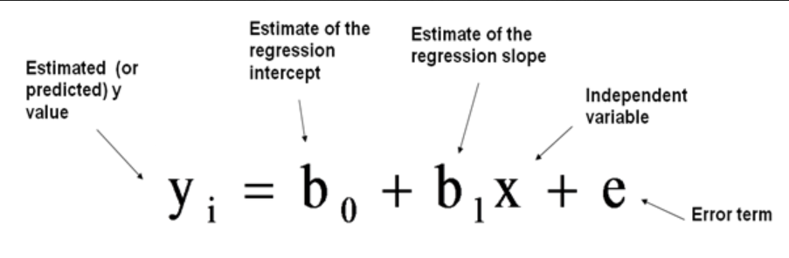
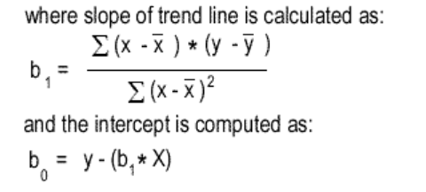

Slide 10
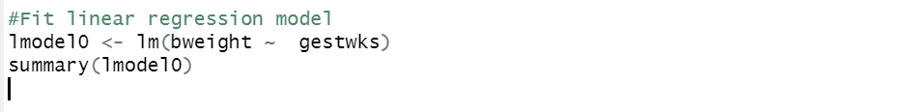

Slide 11
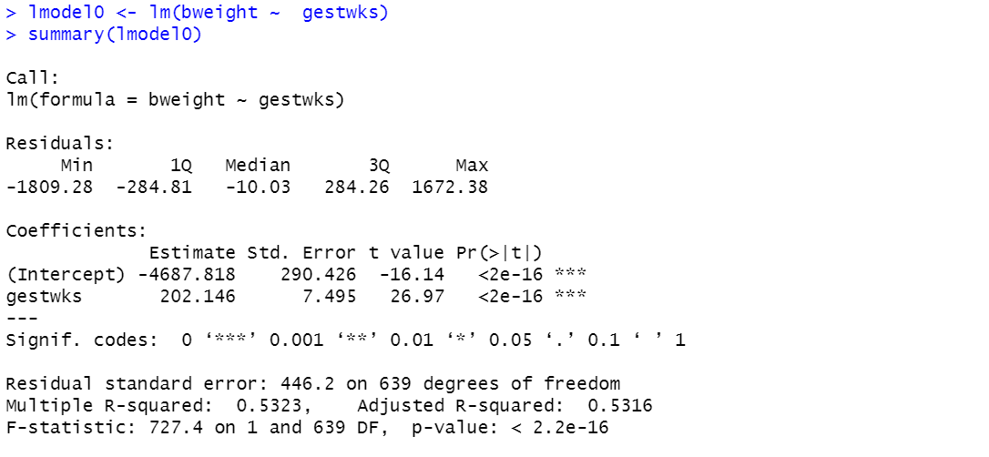

Slide 12
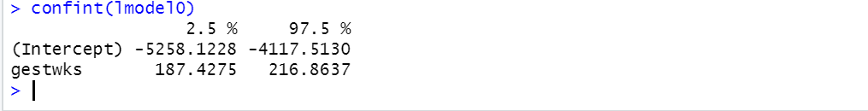

Slide 13
The first section shows the formula that was “called”.
The second section gives the distribution of residuals.
The third section gives coefficients of the
intercept and the effect of ’gestwks’ on birthweight.

Slide 14
Interpreting the coefficients
The intercept is -4687.818 meaning that when the gestwks was zero, the birth weight is estimated to be -4687.818 grams (not interpretable).
The coefficient of ‘gestwks’ is 202.146 indicating that each change in `gestwks’ will cause an average of 202.146 grams birthweight per week, which is highly significant from zero. The multiple R-squared value of 0.5323 indicates that 53.23% of the variation in the data is explained by the model.

Slide 15
From the analysis, it is clear that birthweight is associated with `gestwks’. On average, each `gestwks’ may cause increase of 202.146 grams of birth weight. The remaining uncertainty of birthweight, apart from `gestwks’ , is explained by
random variation or other factors that were not measured.

Slide 16
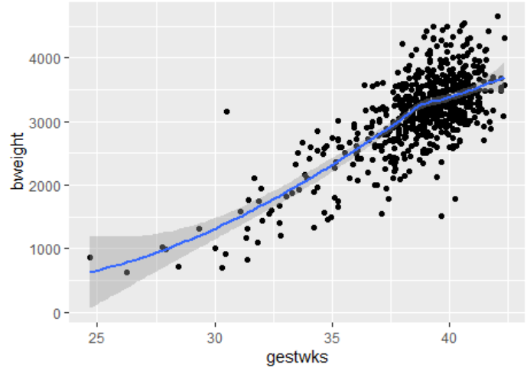

Slide 17
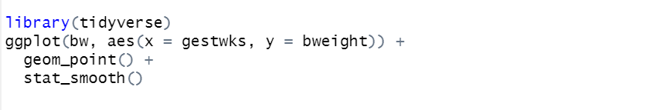

Slide 18
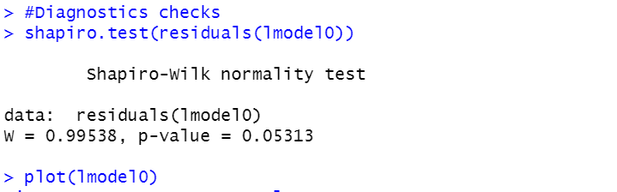
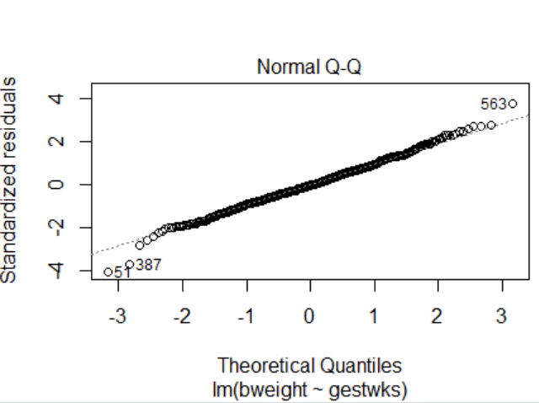

Slide 19
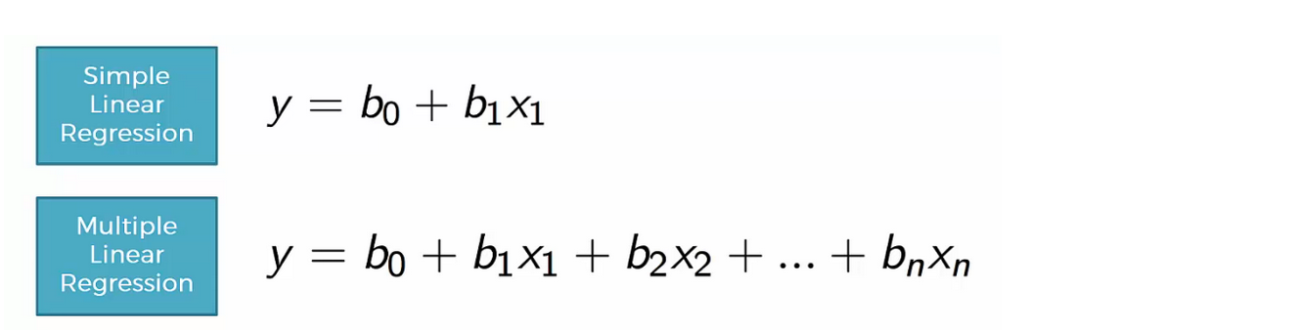
Multiple Linear Regression in R

Slide 20
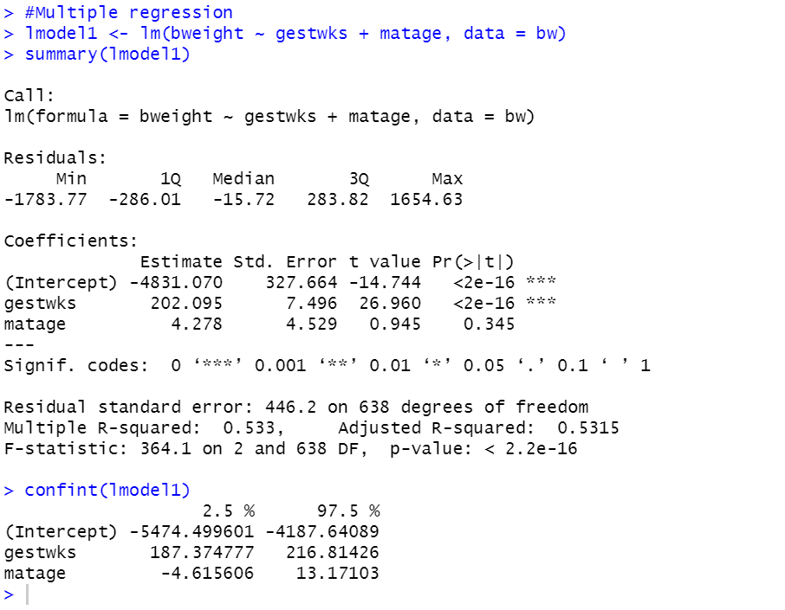

Slide 21
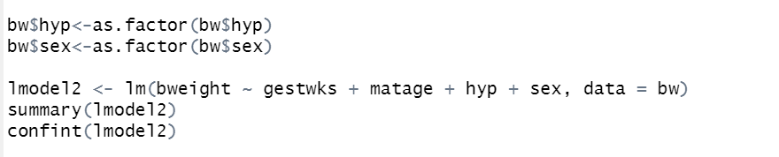

Slide 22
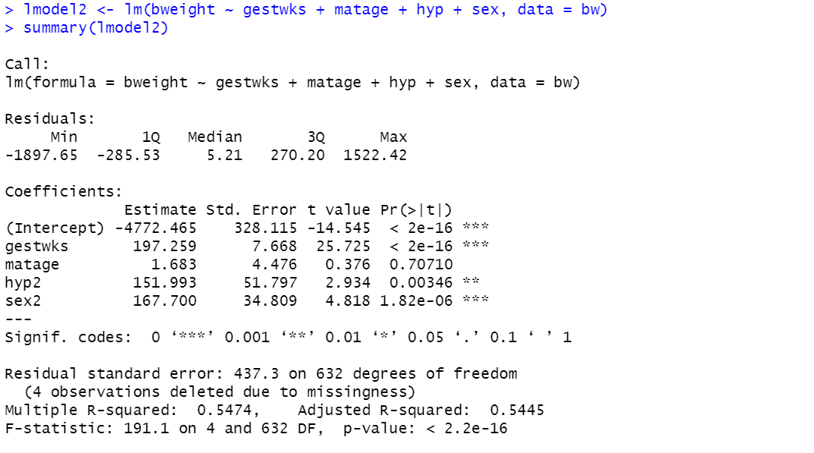

Slide 23
